Slide 1
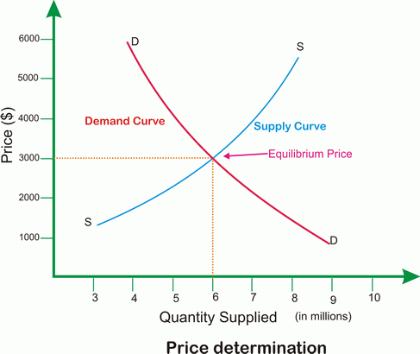
Market Equilibrium (Chapter 3, Powell and Chapter 4, Mankiw)

Slide 2
Definition
Equilibrium is a situation in which opposing forces balance each other. Equilibrium in a market occurs when the price balances the plans of buyers and sellers. The equilibrium price is the price at which the quantity demanded equals the quantity supplied. The equilibrium quantity is the quantity bought and sold at the equilibrium price. A market moves towards its equilibrium because:
Price regulates buying and selling plans.
Price adjusts when plans don’t match.

Slide 3
Graphing the Market (incorporating Demand and Supply)
Unit Price | Quantity Supplied | Quantity Demanded
8.0 | 393 | 44
7.0 | 368 | 67
6.0 | 339 | 93
5.0 | 305 | 124
4.0 | 262 | 162
3.0 | 210 | 210
2.0 | 133 | 280
1.0 | 0 | 400

Slide 4
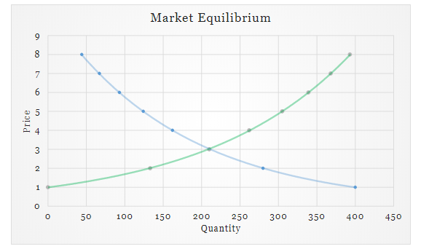

Slide 5
Excess/Shortage Supply and Demand
What would happen if the prices increased above the market equilibrium? (excess supply)
What would happen if prices decreased below the market equilibrium? (excess demand)
What would correct the market and bring towards equilibrium in each of the case?
Recall: Adam Smith’s invisbible hand of competition. The market will clear itself.
Quick question: In which economy do you think, government will control this?

Slide 6
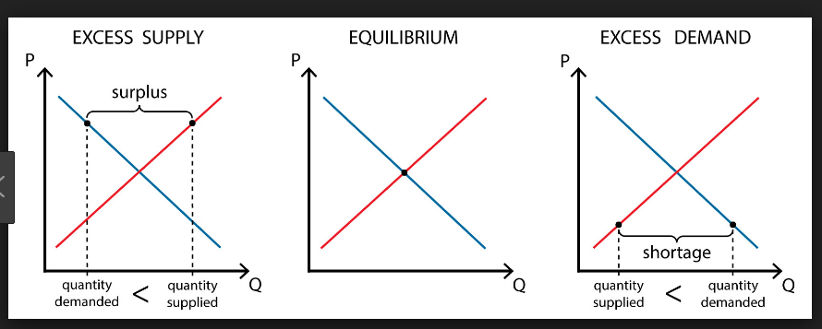

Slide 7
Numerical Examples
Suppose the market for coffee can be represented by a demand and supply curve. And we know that the intersection of demand and supply curve result in the setting of prices, also the equilibrium price and quantity.
Suppose, the demand curve follows and supply curve follows the equation
Now, calculate the market price and quantity?

Slide 8
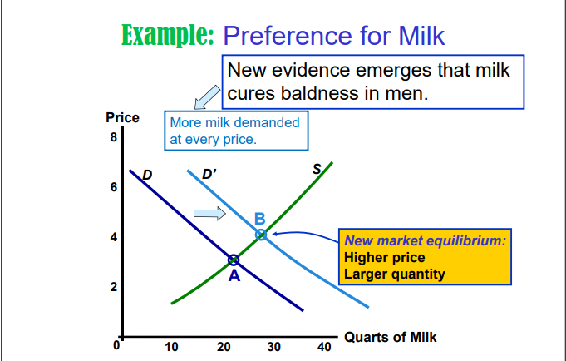
Shifts in Market Equilibrium
If there is an increase in demand, what happens to the market equilibrium?

Slide 9
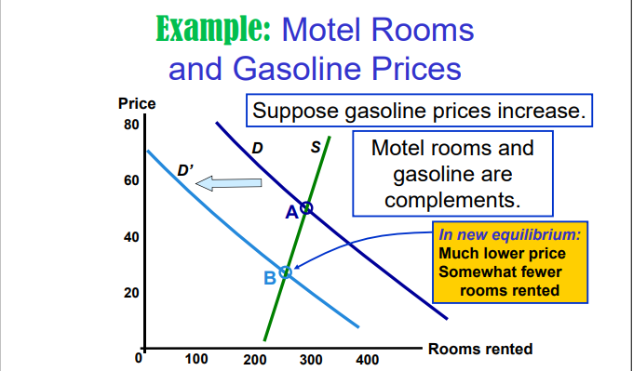
Shifts in Market Equilibirum
2. If there is a decrease in demand, what happens to the equilibrium?

Slide 10
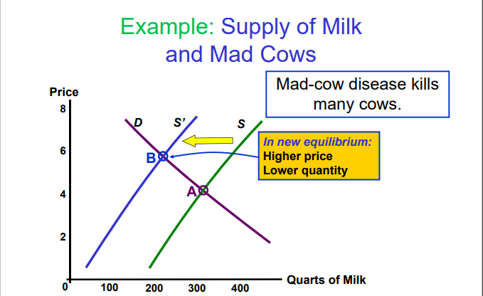
Shifts in Market Equilibirum
3. if there is a decrease in supply, what happens to the equilibrium?

Slide 11
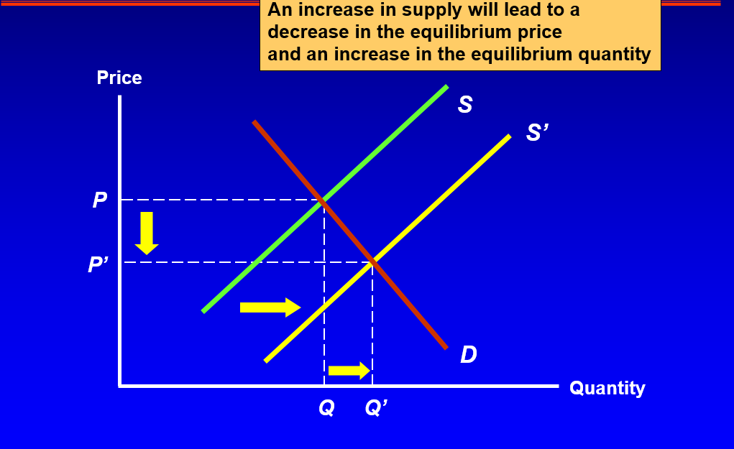
Shifts in Market Equilibirum
4. If there is an increase in supply, what happens to the equilibrium?
Suppose, this is the market for hilsha fish. Indian government has recently opened one of it’s rivers to Bangladesh, which has a large stock of hilsha fish.

Slide 12


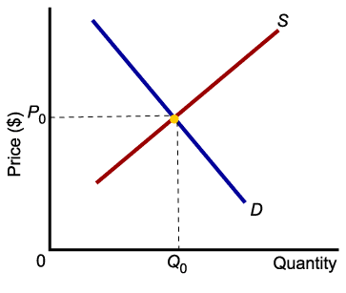
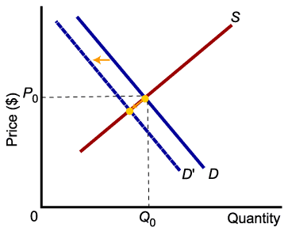
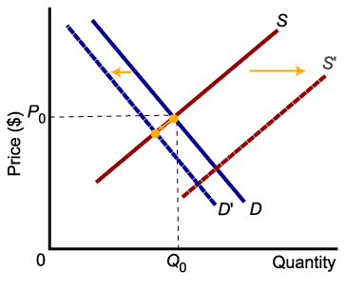
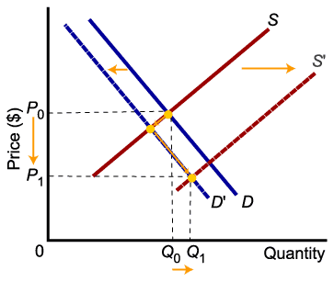
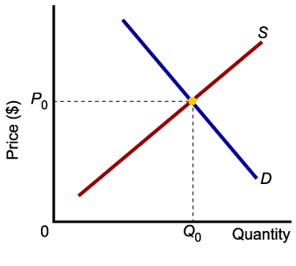
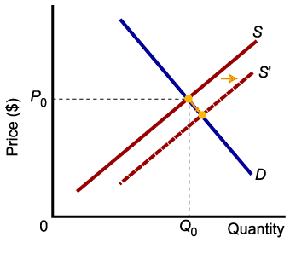
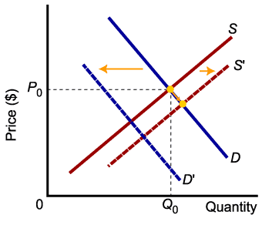
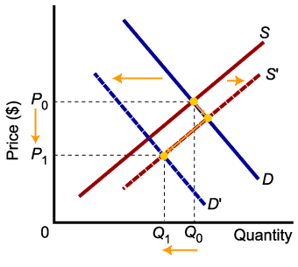
Relative Magnitudes of Change
The relative magnitudes of change in supply and demand determine the outcome of market equilibrium.

Slide 13


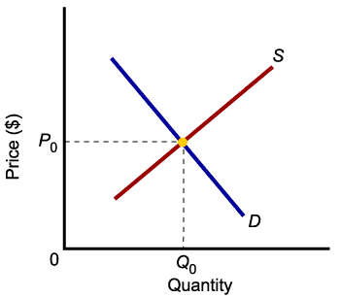
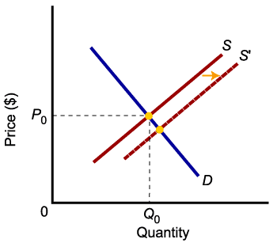
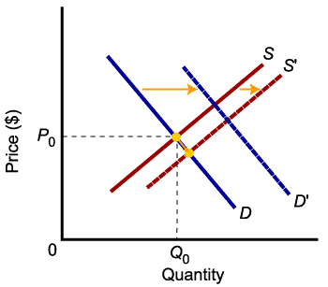
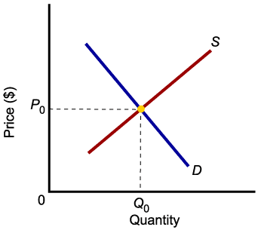
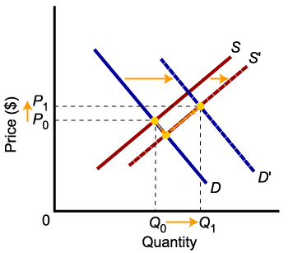
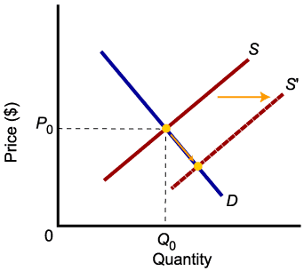
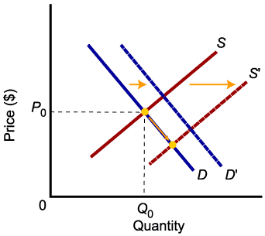
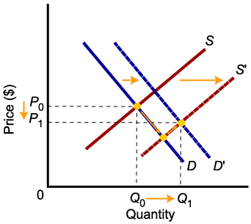
Relative Magnitudes of Change
When supply and demand both increase, quantity will increase, but price may go up or down.

Slide 14
BONUS QUESTION.
There is a long holiday coming during 21st February. Holiday goers are seeing this opportunity and planning to buy tickets before the prices go up. Due to recent wage/salary cuts of pilots, they have gone on a strike. Say that the effect of demand is more than the effect of supply.
Draw the demand and supply diagram and change in market equilibrium. What caused the change, what is the new equilibrium price and quantity?

Slide 15
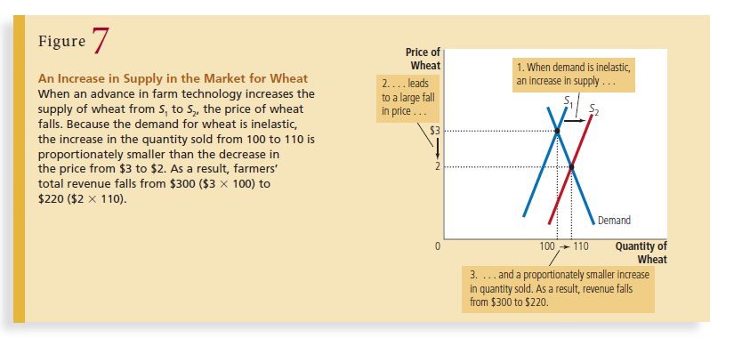
Can Technological Advantage Be good for Farmers? (refer to Mankiw)

Slide 16
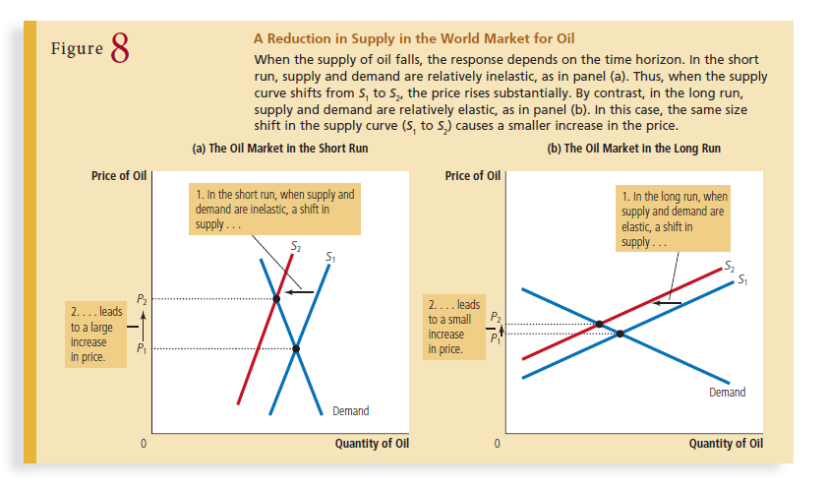
Interesting Market for Oil (OPEC)

Slide 17
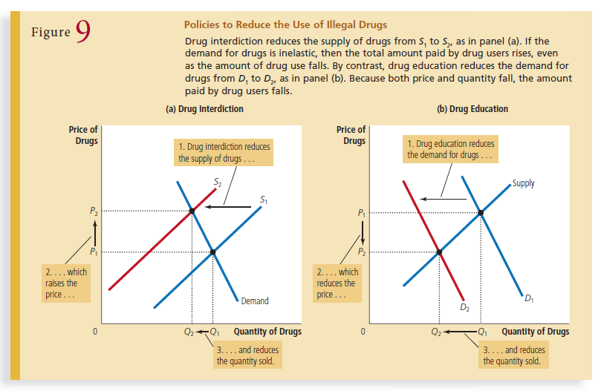
MARKET FOR DRUG-ABUSE

Slide 18
Example: 1
Suppose that one summer the weather is very hot. How does this event affect the market for ice cream? To answer this question, let’s follow our three steps.
1. The hot weather affects the demand curve by changing people’s taste for ice cream. That is, the weather changes the amount of ice cream that people want to buy at any given price. The supply curve is unchanged because the weather does not directly affect the firms that sell ice cream.
2. Because hot weather makes people want to eat more ice cream, the demand curve shifts to the right. Figure 10 shows this increase in demand as the shift in the demand curve from D1 to D2. This shift indicates that the quantity of ice cream demanded is higher at every price.
3. At the old price of $2, there is now an excess demand for ice cream, and this shortage induces firms to raise the price. As Figure 10 shows, the increase in demand raises the equilibrium price from $2.00 to $2.50 and the equilibrium quantity from 7 to 10 cones. In other words, the hot weather increases the price of ice cream and the quantity of ice cream sold.

Slide 19
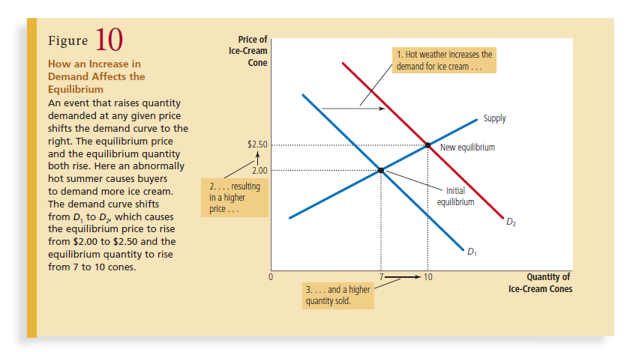

Slide 20
Why did supply not change?
Supply refers to the position of the supply curve, whereas the quantity supplied refers to the amount suppliers wish to sell. In this example, supply does not change because the weather does not alter firms’ desire to sell at any given price. Instead, the hot weather alters consumers’ desire to buy at any given price and thereby shifts the demand curve to the right. The increase in demand causes the equilibrium price to rise. When the price rises, the quantity supplied rises. This increase in quantity supplied is represented by the movement along the supply curve.

Slide 21
Example 2
Suppose that during another summer, a hurricane destroys part of the sugarcane crop and drives up the price of sugar. How does this event affect the market for ice cream?
1. The change in the price of sugar, an input for making ice cream, affects the supply curve. By raising the costs of production, it reduces the amount of ice cream that firms produce and sell at any given price. The demand curve does not change because the higher cost of inputs does not directly affect the amount of ice cream households wish to buy.
2. The supply curve shifts to the left because, at every price, the total amount that firms are willing and able to sell is reduced. Figure 11 illustrates this decrease in supply as a shift in the supply curve from S1 to S2.
3. At the old price of $2, there is now an excess demand for ice cream, and this shortage causes firms to raise the price. As Figure 11 shows, the shift in the supply curve raises the equilibrium price from $2.00 to $2.50 and lowers the equilibrium quantity from 7 to 4 cones. As a result of the sugar price increase, the price of ice cream rises, and the quantity of ice cream sold falls.

Slide 22
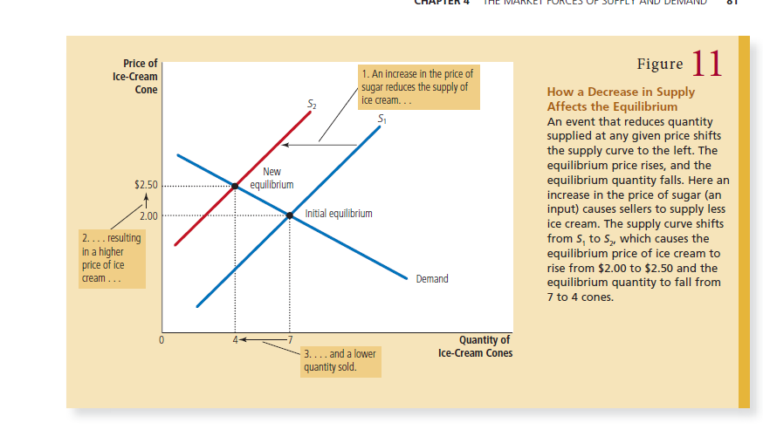

Slide 23
Midterm Review
Three steps to analyzing changes in Equilibrium:
1. Decide whether the event shifts the supply or demand curve (or perhaps both).
2. Decide in which direction the curve shifts.
3. Use the supply-and-demand diagram to see how the shift changes the equilibrium price and quantity.

